Slide 1
How imputation techniques interact with machine learning algorithms?
Martyna Majchrzak Agata Makarewicz
Jacek Wiśniewski

Slide 2
Imputation
the process of replacing missing data with substituted values
substantial part of reprocessing data used for machine learning models

Slide 3
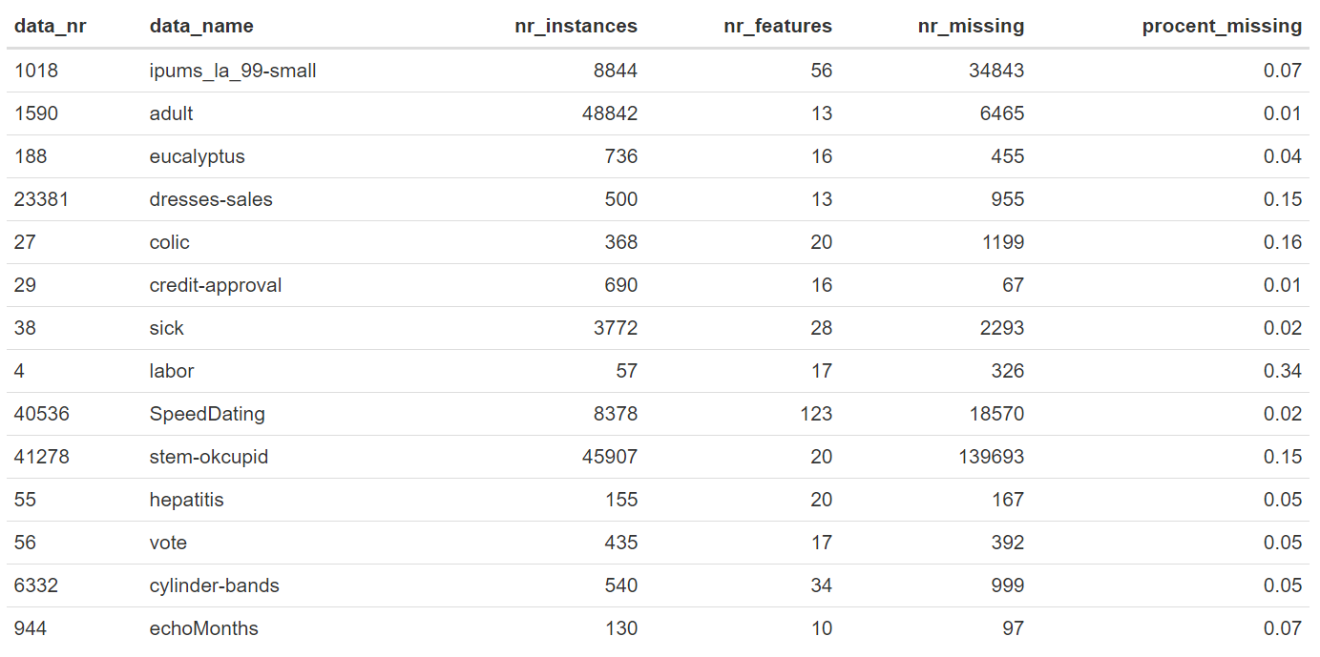
Datasets

Slide 4
Imputation methods
mean/mode imputation
mice (predictive mean matching) (mice package)
k-nearest neighbours (VIM package)
hotdeck (VIM package)
softImpute combined with median/mode imputation (softImpute, ImputeMissings packages)

Slide 5
Classification algorithms
RPART (Recursive Partitioning And Regression Trees)
NB (Naive Bayes)
Ranger (Random forest)
LDA (Linear Discriminant Analysis)
KKNN (Weighted k-Nearest Neighbour)

Slide 6
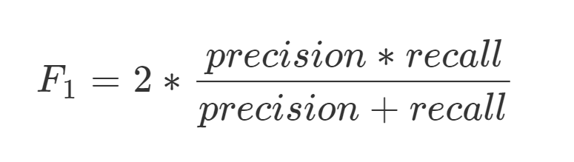
Measure
F1 Measure
harmonic mean of the precision and recall.

Slide 7
Ranking
Each imputation receives rank depending on their performance
NA receives worst mark
Mean rank is the final for model

Slide 8
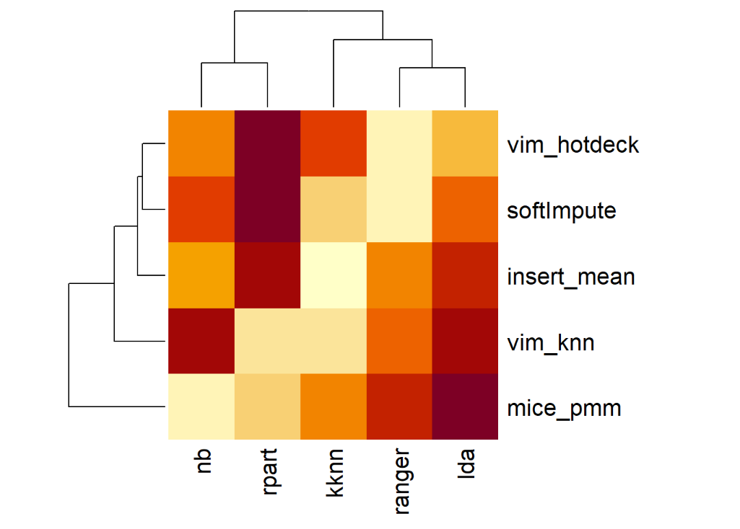
Results for all datasets

Slide 9
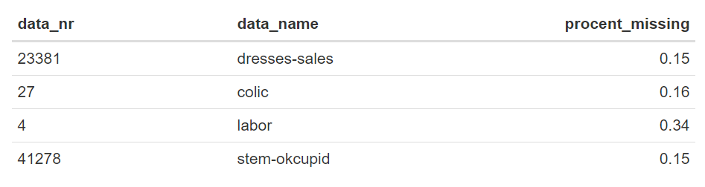
Datasets with high percent of missing

Slide 10
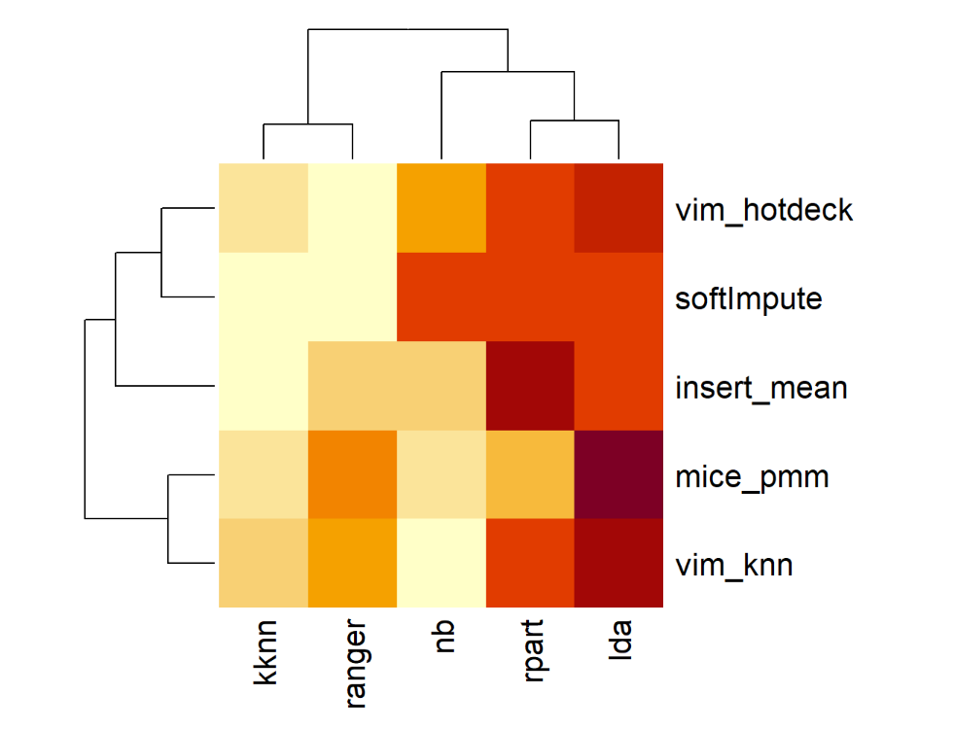
Datasets with high percent of missing

Slide 11
Thank you :)

